Slide 1
Law Enforcement Logistics and Asset Management Symposium
Asset Leadership Network Initiative
December, 2019

Slide 2
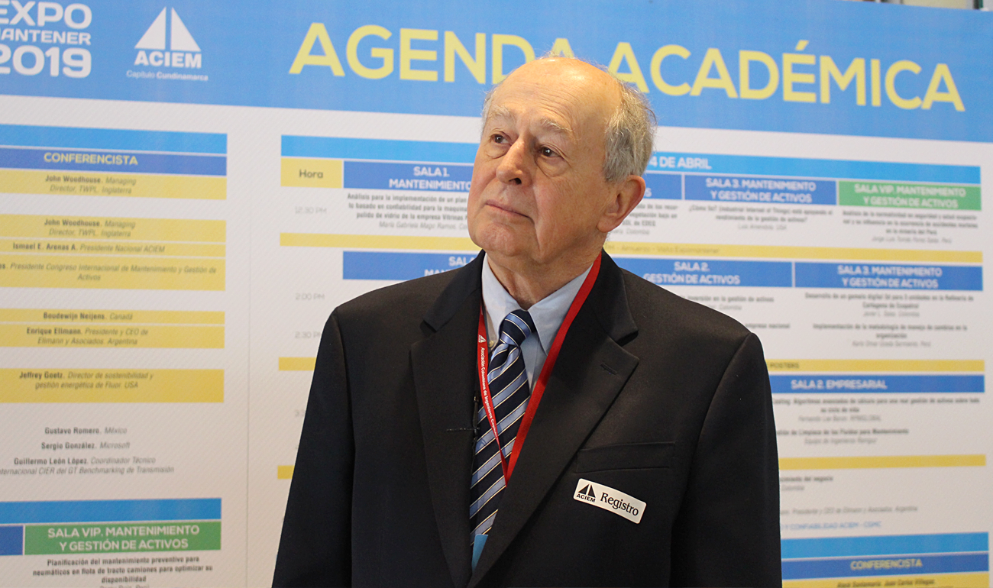
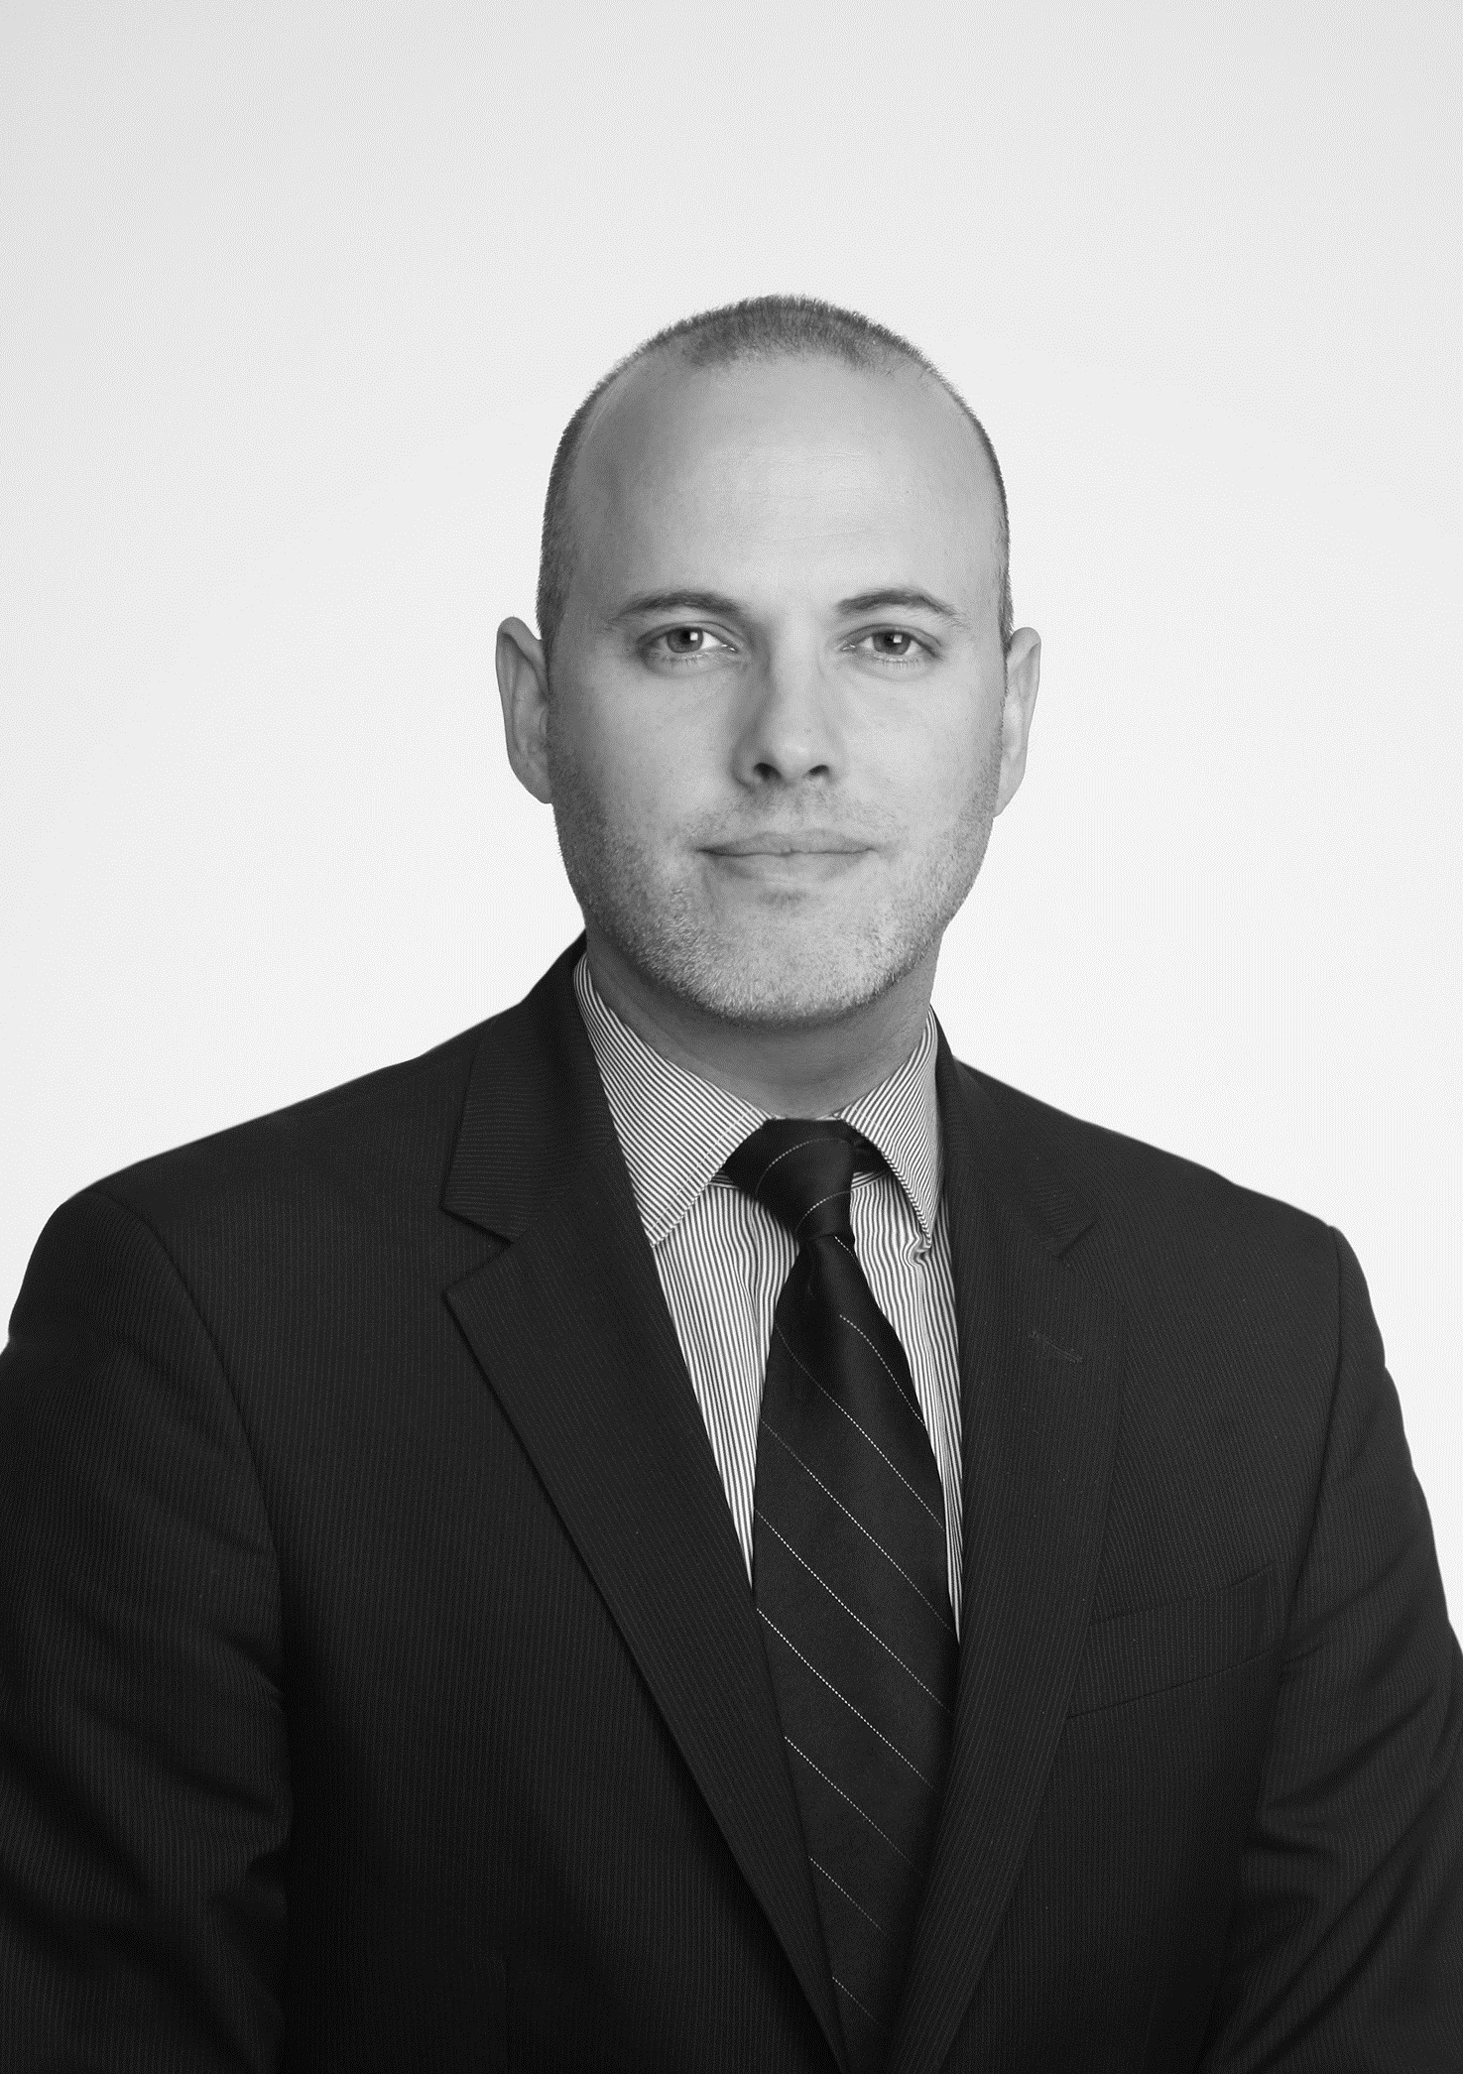
Agenda
Introductions
Formation of the Law Enforcement Logistics and Asset Management Working Group
Presentations
Round-table Discussion
Next Steps
Jim Dieter
Asset Leadership Network,
Chief Executive Officer
Moshe Nelson
ALN Member, Grant Thornton
Asset Management Solution Lead

Slide 3
The Asset Leadership Network
The Asset Leadership Network is a not for profit trade association focused on impacting asset management across all industries, markets, and sectors.
The Asset Leadership Network provides a forum where individuals and organizations build relationships, identify best practices and work together to shape the efficient management of assets.

Slide 4
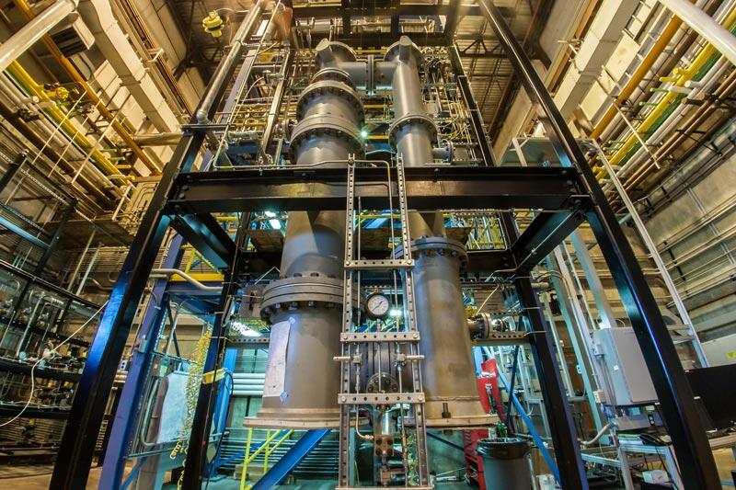
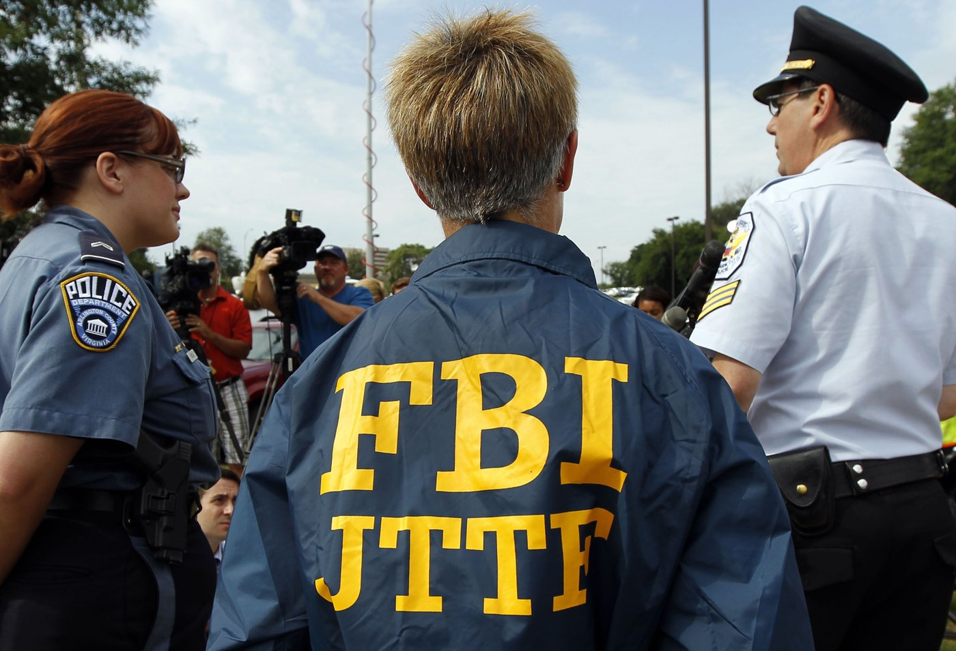
The Law Enforcement Logistics and Asset Management Working Group
Goals and Outcomes of the Symposium
Support cross-governmental collaboration
Identify and share best practices
Identify efficiencies and cost-saving opportunities
Discuss solutions to law enforcement's specific set of asset management challenges
Law enforcement asset management retains its own set of challenges, standards, and best practices. As such, the federal law enforcement asset management community requires a forum to collaborate on law enforcement-specific asset management needs and solutions.

Slide 5
Steering Committee Overview
ALN stood up a Joint Steering Committee, comprised of ALN members and federal leaders with expertise in asset management, and met a total of four times to plan the Symposium.
The Steering Committee:
Supported the selection of Symposium topics of interest
Provided input in identifying Symposium leaders
Provided perspectives and recommendations on proposed Symposium planning
Charlie Ford | Chief, Property, Acquisitions and Safety Division | Bureau of Alcohol, Tobacco, and Firearms
Christian Van Ginder | Director, Mobile Assets Program Management Office | U.S. Customs and Border Protection
Karen Lopez | Chief, Asset Management | Federal Bureau of Investigations
Cle Jones | Unit Chief, Logistics | Federal Bureau of Investigations
Al Green | Chief, Asset Management Division | Immigration and Customs Enforcement
Bill Garrett | Director, Mobile Assets and Personal Property | Department of Homeland Security
Eric Brown | Assistant Director, Mobile Assets | Department of Homeland Security
Jim Dieter, ALN
Moshe Nelson, ALN-GT
Katie Smoots, ALN-GT
Steve Katz, ALN-GT
Ed Safdie, ALN-GT

Slide 6
Prioritized Discussion Topics, as chosen by the Steering Committee
The Joint Steering Committee voiced topics of interest, which were combined into a shortlist of just ten topics.
1 | Inventory best practices and tech | Leveraging technology to modernize inventory
2 | Acquisition and disposal | Standardizing the supply chain
3 | Governing body oversight | Inquiries into agency accountability
4 | Telematics | Implementing telematics w/ security sensitivity
5 | Property management supply chain | The entire lifecycle of property management
6 | Passive and active tracking updates | Low cost tracking of sensitive assets
7 | SAVE Act (DHS) and similar practices for other Agencies | Scrutiny over property management programs across federal agencies
8 | Home-to-work programs | Improving oversight and management
9 | DoD Reuse program | How to leverage the program responsibly in order to save money on property equipment
10 | Alternative revenue streams | Maximizing budgets through asset resale
11 | Mission impact and alignment | Role of asset management to the mission
Today’s Topics
Mission impact and alignment
The technological future of asset management
Passive and active tracking, telematics

Slide 7
Today's Presentations
9:00-9:45: Keynote Speaker “The Importance of Asset Management in Fulfilling the Mission”, Kris Cline, Deputy Director Federal Protective Service
9:45-10:30: Future Innovation in Asset Management - Boston Consulting Group, Matthew Leybold
10:45-11:30: Use Case - Technological Innovation through Telematics, RFID and Warehousing, Barcoding.com, Jay Steinmetz & Noel McKeon

Slide 8
Next Steps
Obtain feedback from symposium and brief out Steering Committee
Synthesize feedback and brief community
Set date for best practice sharing event – Symposium II

